Slide 1



TEAM KODAK
SmartHirePRO
CS691 CRN21669

Slide 2
Agenda
Team Member Roles and Responsibilities
Product Backlog
Project Description
Sprint 2
Team working agreement
Metrics
Personas
Retrospective
Technologies and Algorithms
Sprint 3
Diagrams
Project Demo

Slide 3
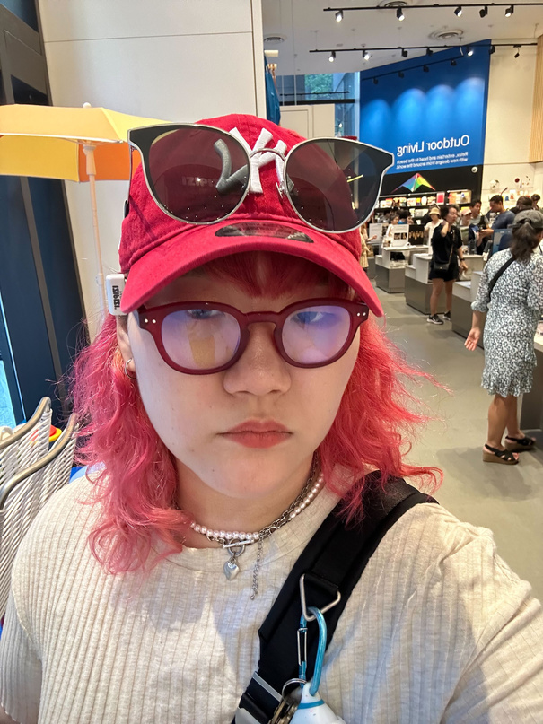



Team Member Roles and Responsiblities
Seungah choi
Full Stack Developer
Yadu Vamsi U.
Full Stack Developer
Sreeja Karukonda
QA Analyst and DBA
Aashlesha Shirole
Front-End Developer

Slide 4
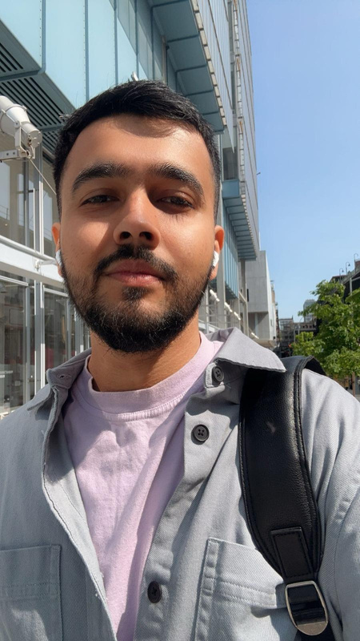



Team Member Roles and Responsiblities
Hrushikesh Joshi
Backend and Data Engineer
Sujay Sail
DevOps Engineer
Ashish Sudam
Data Engineer
Yash Jani
Front-End Developer(React)
Site Reliability Engineer

Slide 5

Improvements
Reduce the number of bullet points
Included algorithms
Included GitHub link to the presentation

Slide 6
Project Description
Project Name: | Smart Hire Pro
Team: | Kodak
Project Description: | Our project aims to create a job recommendation system that provides the user with a targeted list of jobs based on the skills and experience in the resume of the user
Benefit Outcomes: | Users can monitor their skill gaps to enhance their future job search strategies. The idea suggests an improved approach to applying or searching for a job in the hopes of reducing failed job applications.
Github Link: | https://github.com/htmw/2024S-Kodak/wiki

Slide 7
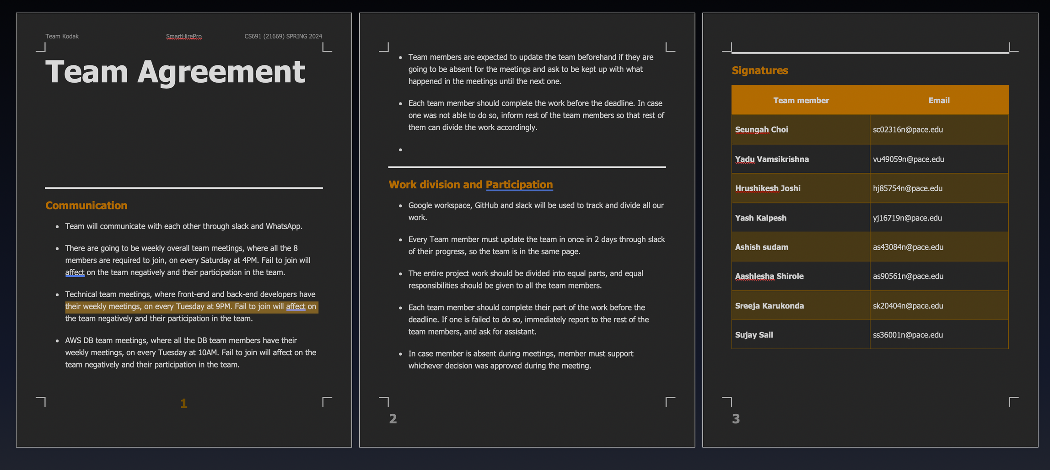

Team Working Agreement

Slide 8

Maria, the Ambitious Software
Engineer
"I'm tired of spending hours searching for jobs that aren't right for me. This platform seems like a great way to ﬁnd relevant opportunities that match my skills and career goals."
Demographics:
Age: 24
Location: Amsterdam, Netherlands
Education: Bachelor of Arts in Film and Screen studies
Experience: none
Skills and Qualifications:
Proficient in Python, Java, and JavaScript
Experience with web development and machine learning
Strong analytical and problem-solving skills
Excellent communication and teamwork abilities
Goals and Needs:
Looking for a challenging and rewarding software engineering role that utilizes her skills and experience.
Wants to find a job that aligns with her interests and career aspirations.
Struggles to stay up-to-date on the latest job openings and find relevant opportunities that match her profile.

Slide 9
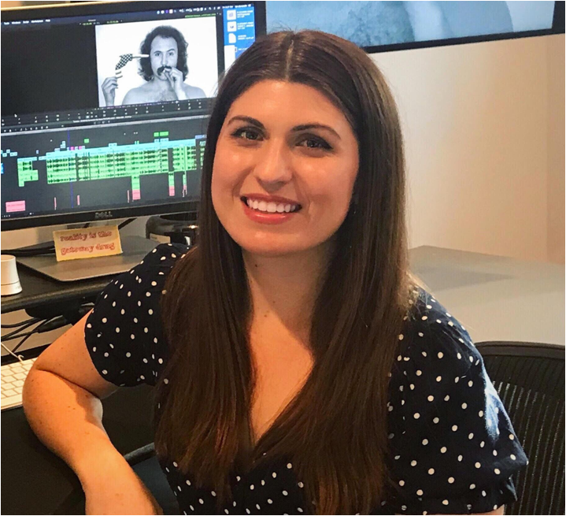
Audrey, Film editor
Demographics:
Age: 24
Location: Amsterdam, Netherlands
Education: Bachelor of Arts in Film and Screen studies
Experience: none
Skills and Qualifications:
Proficient in adobe suites, and some Avid video editing
Experience with filming with a 16mm camera
Strong communication and problem-solving skills
Great teamwork abilities
Goals and Needs:
Searching for a full-time opportunity that uses her degree
To have a personal assistant-like tool that will suggest as many jobs as there are in the market

Slide 10

Daiman, Technical Support Assistant
Demographics:
Age: 27
Location: Birmingham, UK
Education: Bachelor's Degree in IT
Experience: 2 yrs
Skills and Qualifications:
Experience in Technical Support
Certified AWS CPP
100 hrs plus Data Science courses completed on Datacamp
Competed in multiple hackathons based on machine learning on HackerEarth
Goals and Needs:
Determine to change career paths from technical support to a career in Data science
After countless unfruitful applications, looking job recommendations that encapsulates all his recently acquired skills

Slide 11
MVP
Core Functionality:
Resume Parsing:
Basic skill and experience extraction using pre-trained models or simple keyword matching.
No complex semantic analysis or advanced natural language processing (NLP) at this stage
Job Search:
Connect to the reed.co.uk Jobseeker API using basic search capabilities based on extracted keywords from the resume.
Initially, return a simple list of matching jobs without ranking or compatibility scoring.
User Interface:
Simple web interface:
Allow users to upload their resumes and receive a list of relevant job postings from reed.co.uk.
No fancy features or complex navigation at this stage.
Metrics and Feedback:
Track basic usage metrics like number of users, resumes uploaded, and job searches conducted.
Gather user feedback through surveys or interviews to understand their experience and pain points.
Key Learnings:
Validate the core concept of using AI to recommend jobs based on resumes.
Identify the most valuable features and functionalities to prioritize in future development.
Gain insights into user behavior and preferences to refine the product roadmap.

Slide 12
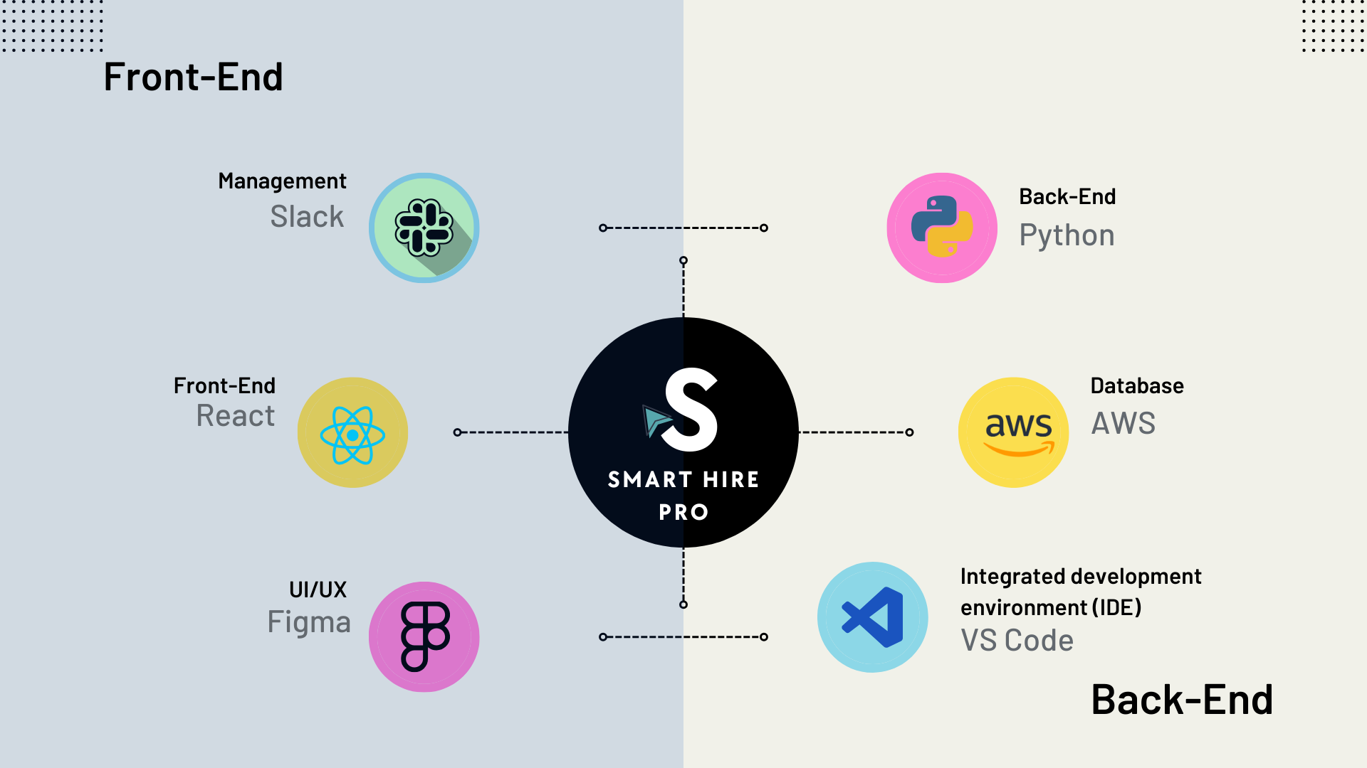
Technologies

Slide 13

Algorithms
Module
Resume Parser
Agent
TextRank
Spacy
RE
Target
Name
Contact Info
Keywords

Slide 14

Diagrams

Slide 15
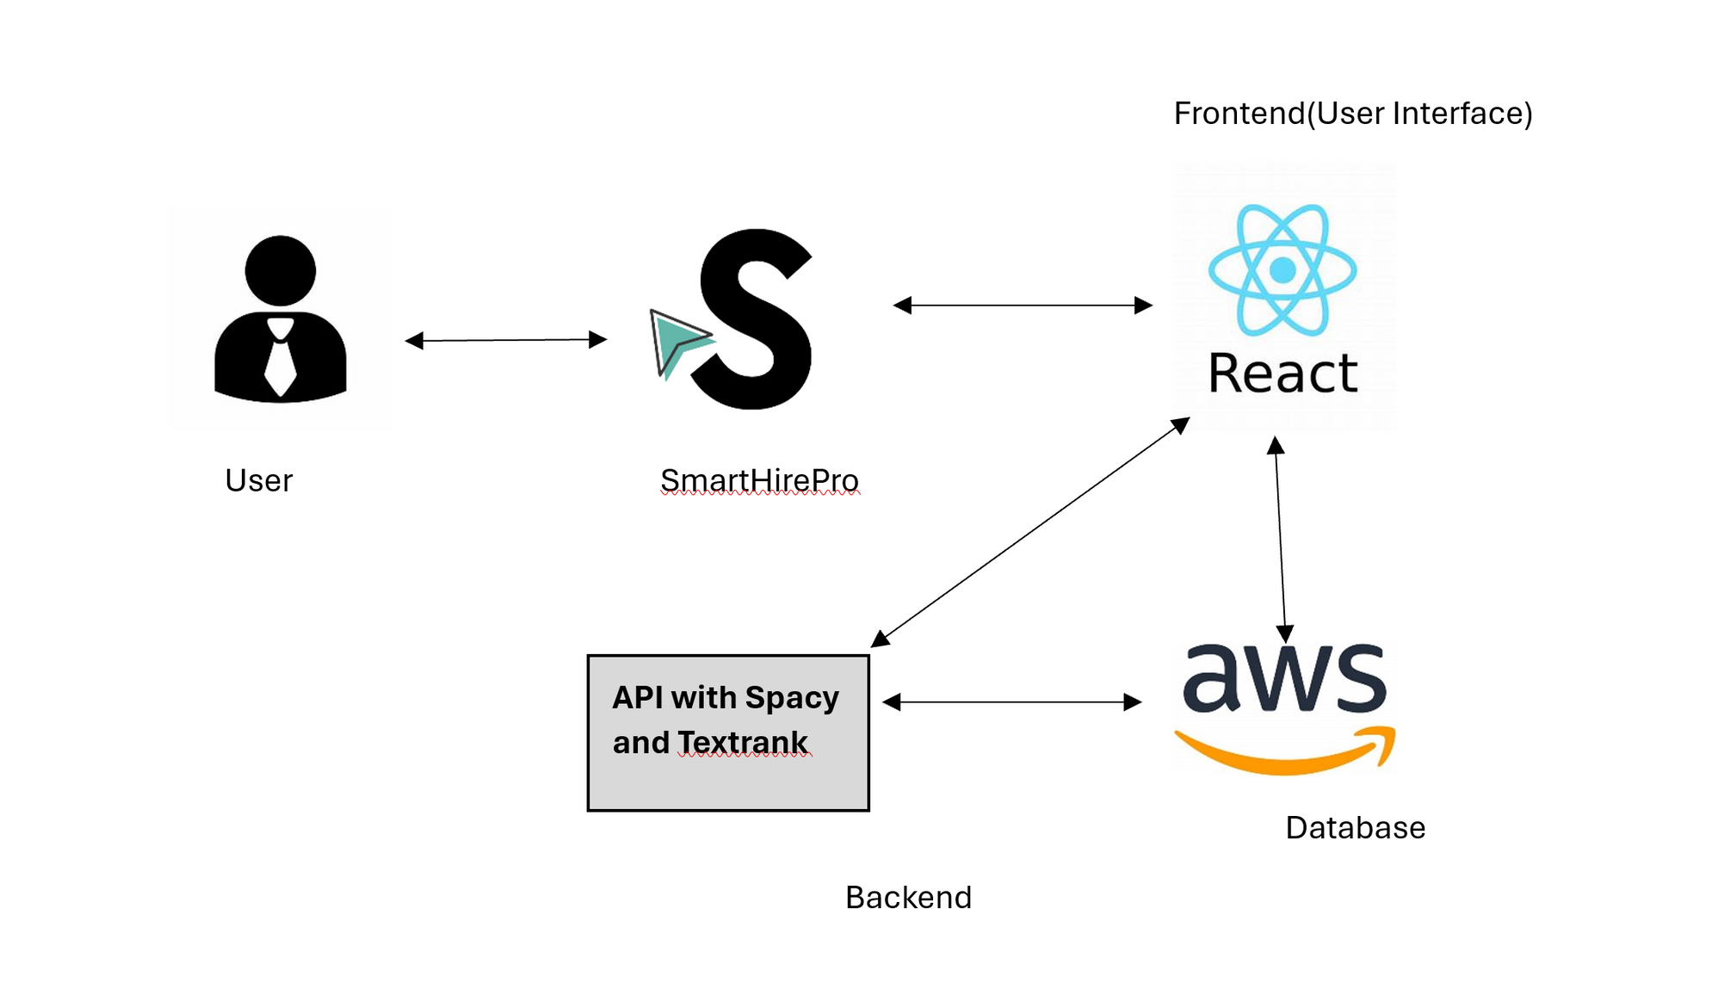

Architecture Diagram

Slide 16
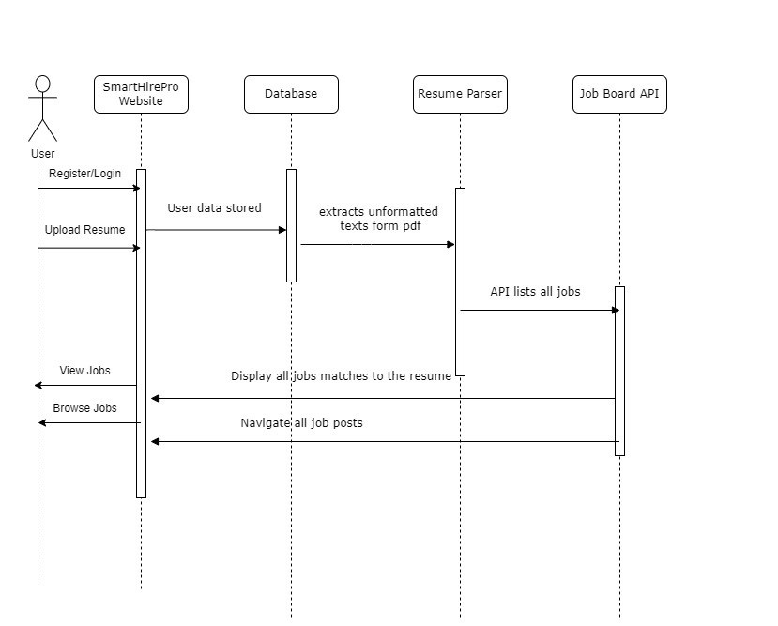
Sequence Diagram

Slide 17
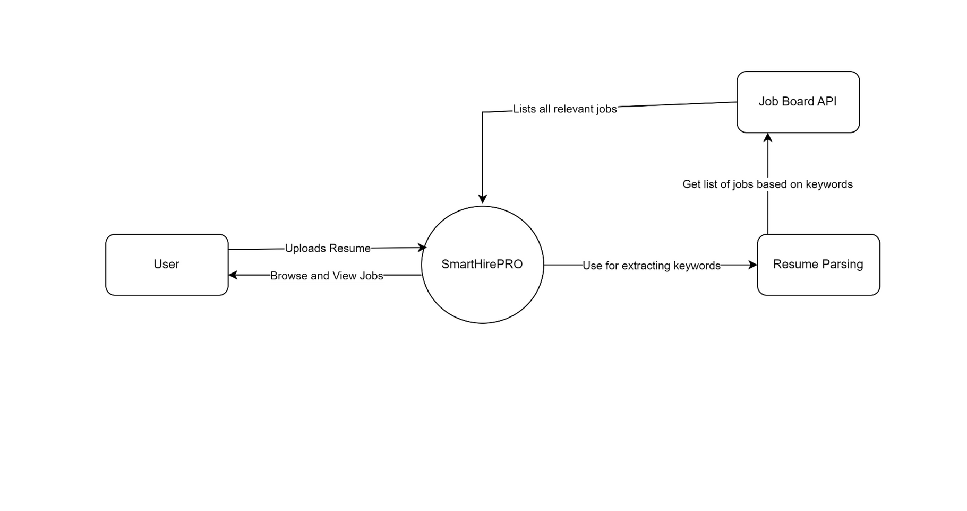
Context Diagram

Slide 18
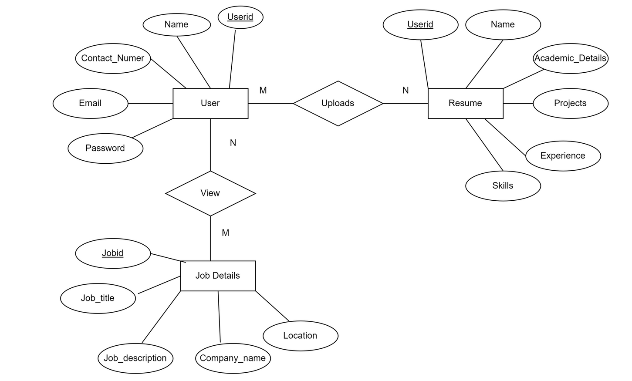
ER Diagram

Slide 19
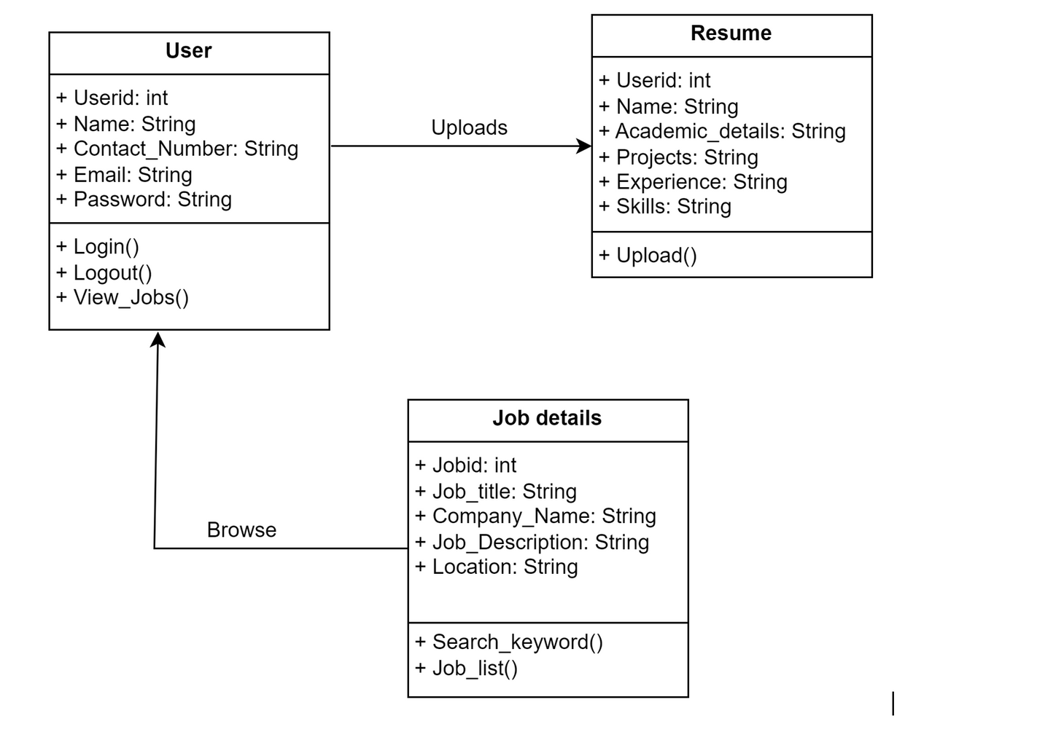
Class Diagram

Slide 20
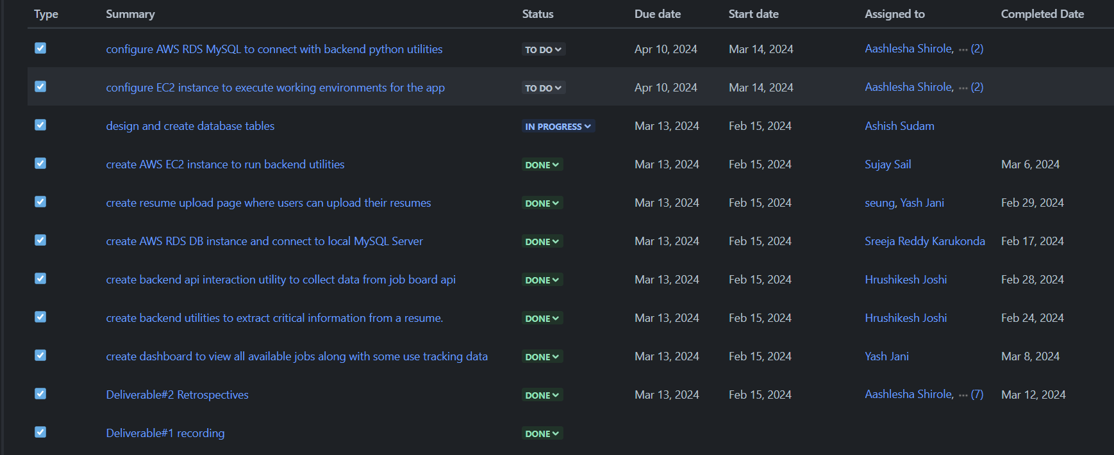
Product Backlog

Slide 21
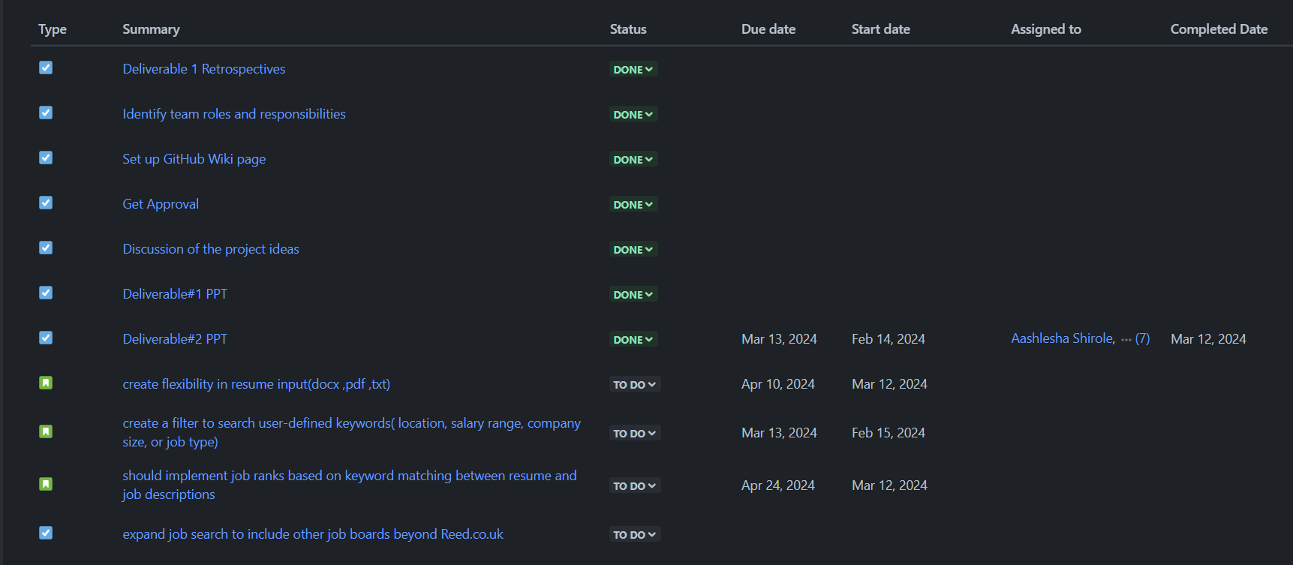
Product Backlog Cont.

Slide 22
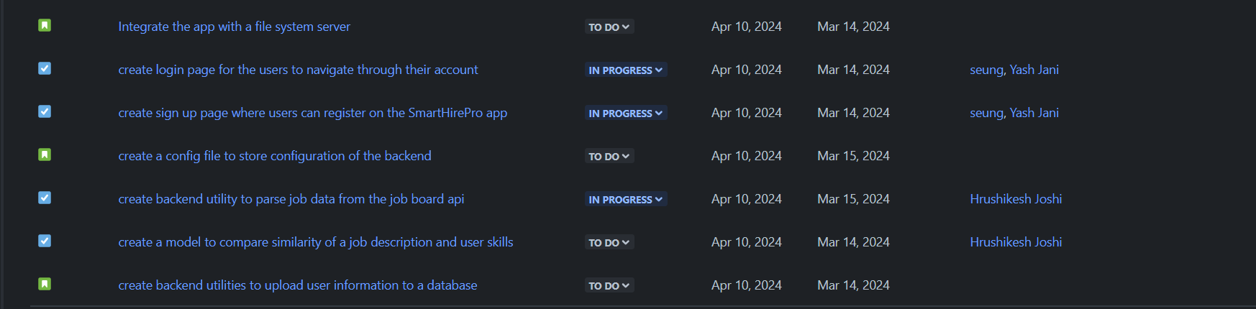
Product Backlog Cont.

Slide 23
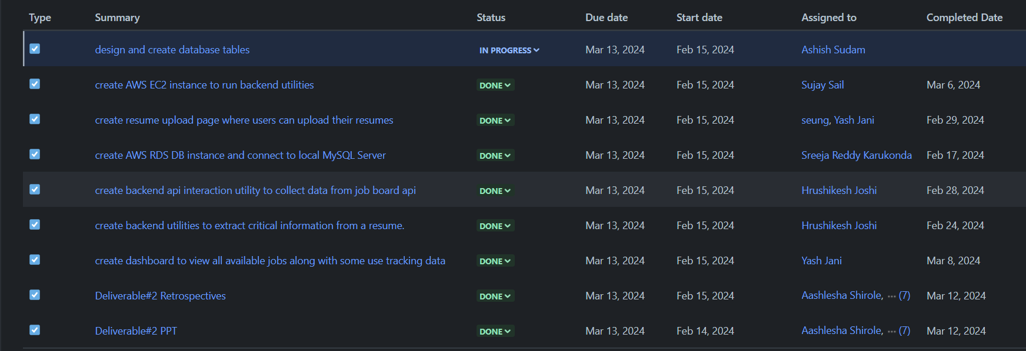
Sprint 2 Backlog

Slide 24

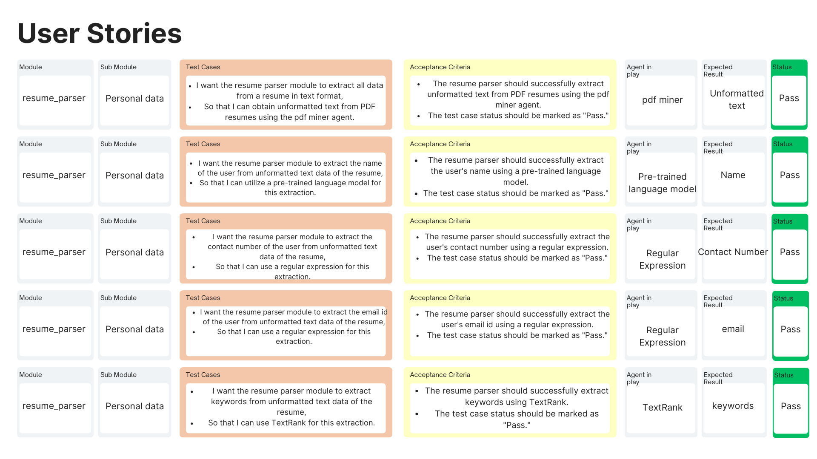
Test cases
/user stories
/user stories
/user stories
/user stories
/user stories

Slide 25
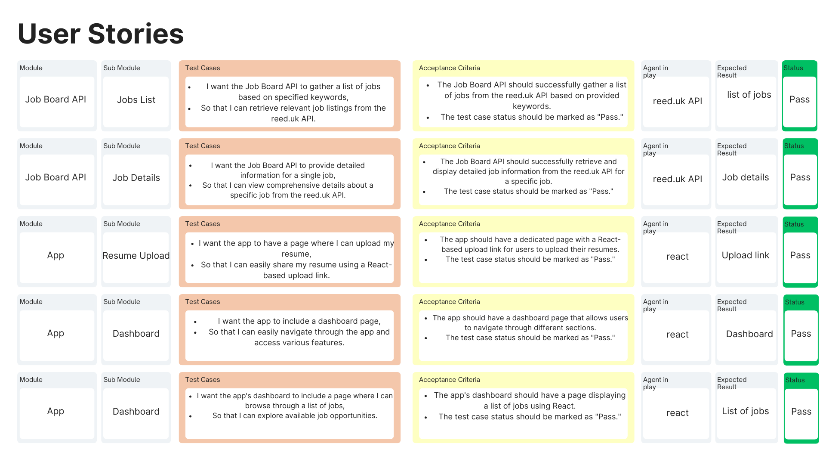
Test cases cont.
/user stories
/user stories
/user stories
/user stories
/user stories

Slide 26
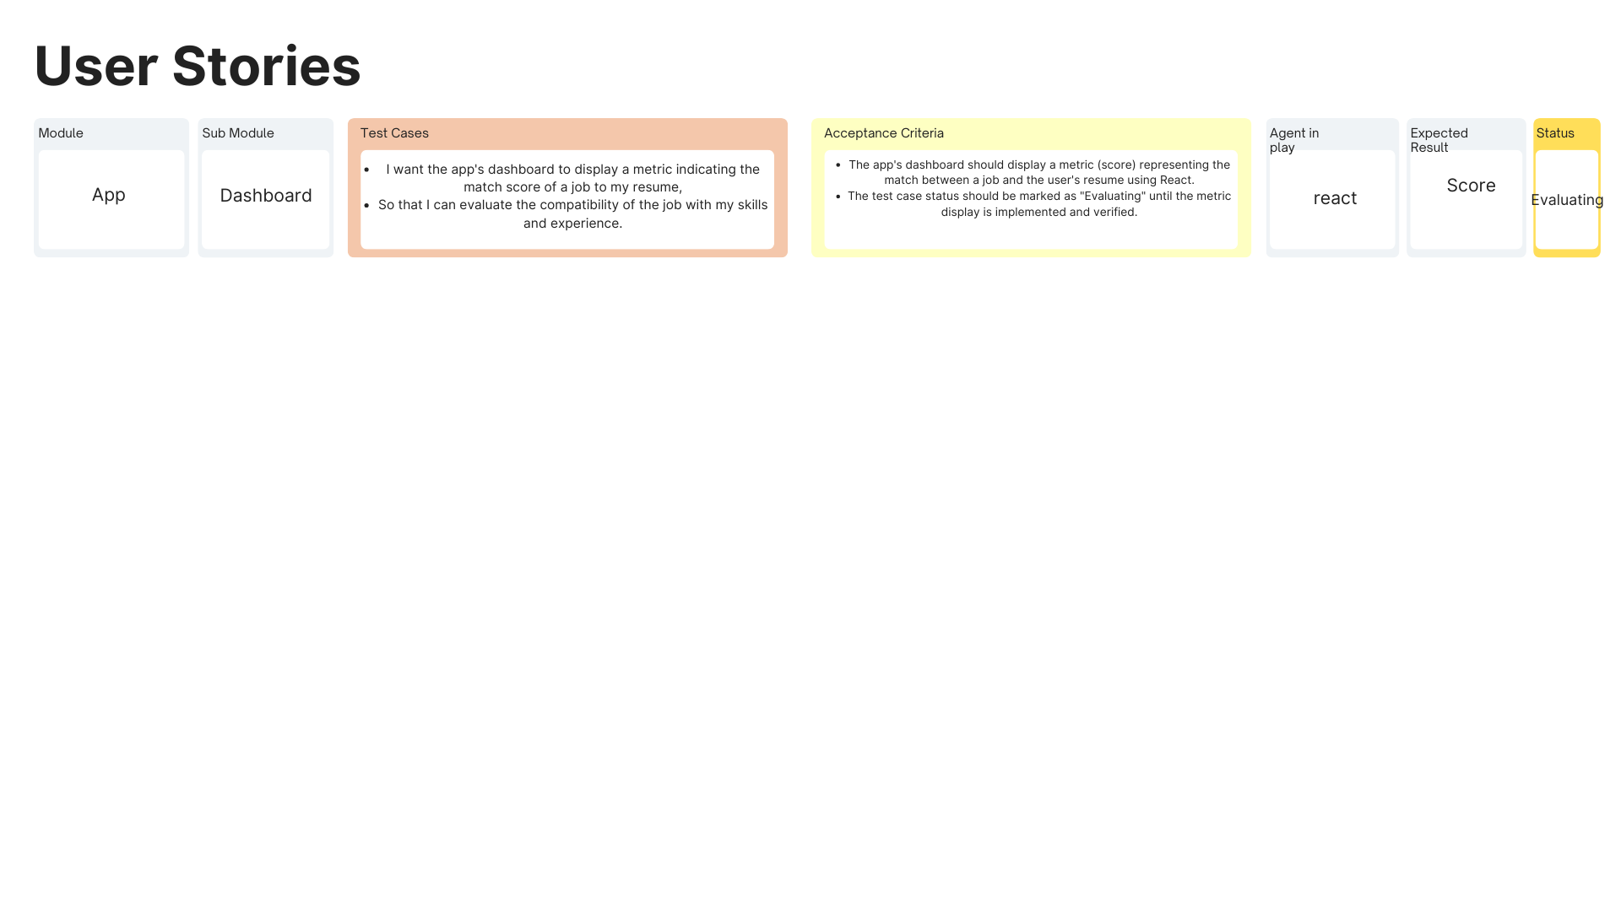
Test cases cont.
/user stories

Slide 27

Acceptance Criteria
Id | User Story | Status | Place
1 | As a job seeker I want to be able to browse through jobs so that I can review jobs that I can apply to. | To do | Dashboard
1 | Scenario: User is job hunting Given I'm a job seeker Then SmartHirePro should provide me with a list of jobs. | To do | Dashboard
2 | As a job seeker I want to delve into demands of the industry so that I can update myself to the industry standard. | To do | Dashboard
2 | Scenario: User wants to investigate jobs Given I'm a job seeker When I click on a job Then I can investigate the demands and rewards of a job. | To do | Dashboard
3 | As a job seeker I want to delve into demands of the industry so that I can update myself to the industry standard. | To do | Job Details
3 | Scenario: User wants to investigate jobs Given I'm a job seeker When I click on a job Then I can investigate the demands and rewards of a job. | To do | Job Details

Slide 28
Acceptance Criteria Cont.
Id | User Story | Status | Place
4 | As a job seeker I want to devote my time applying to only those jobs that suit me so that I increase my chance of getting hired. | To do | Dashboard
4 | Scenario: User is on a deadline for job hunting Given I'm a job seeker When I am hunting for jobs Then I only want to browse jobs that are suitable for me | To do | Dashboard
5 | As a job seeker I want to discover values and specifics of the employer and position so that I can determine if my interests and skills are aligned. | To do | Job Details
5 | Scenario: User is seeking for a job that encompasses his skills and interests Given I'm a user When I review a job Then I should see exhaustive details of the job. | To do | Job Details
6 | As a job seeker I want to know if a job matches my profile so that I know I am applying to a job that is right for me. | To do | Dashboard (Score)
6 | Scenario: User is hunting for a job Given I'm a job seeker When I browse through a job Then SmartHirePro should reveal if the job is suitable for me. | To do | Dashboard (Score)

Slide 29
Acceptance Criteria Cont.
Id | User Story | Status | Place
7 | As a job seeker I want to quantify the match of my profile and a job so that I can put in extra efforts for an application and plan ahead. | To do | Dashboard (Score)
7 | Scenario: User wants to reveal the suitability of job Given I'm a job seeker When I see a job that is a match for my profile Then I want a quantifiable score of the match. | To do | Dashboard (Score)

Slide 30
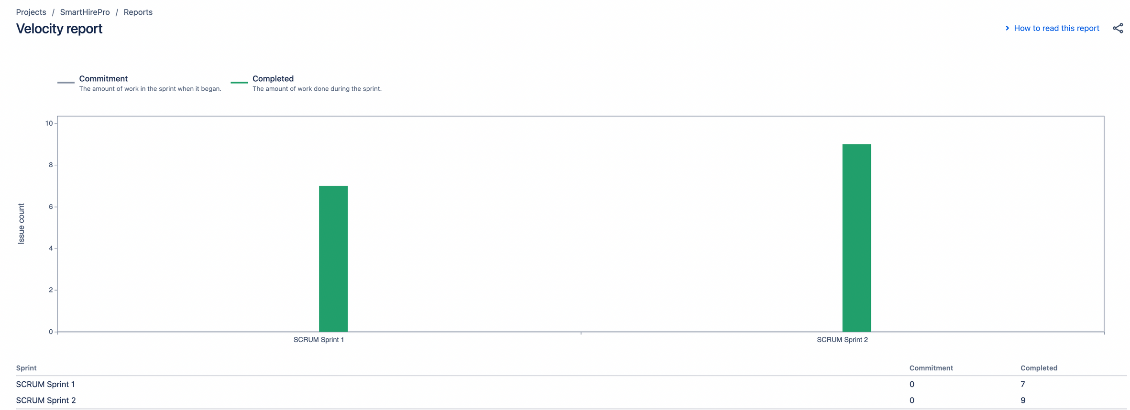
Team velocity
7
1

Slide 31


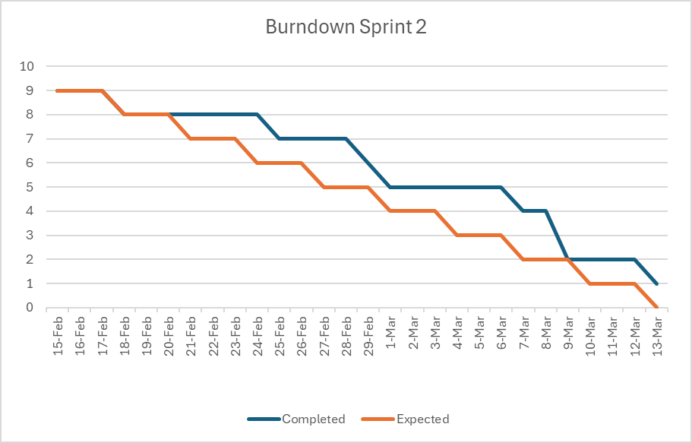
Burndown Charts

Slide 32


Completed/Committed Ratio
8/9 = 88%
Done 88% In progress 12% Not started 0%

Slide 33

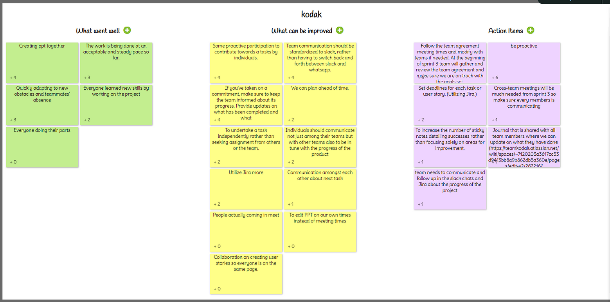
Retrospectives

Slide 34
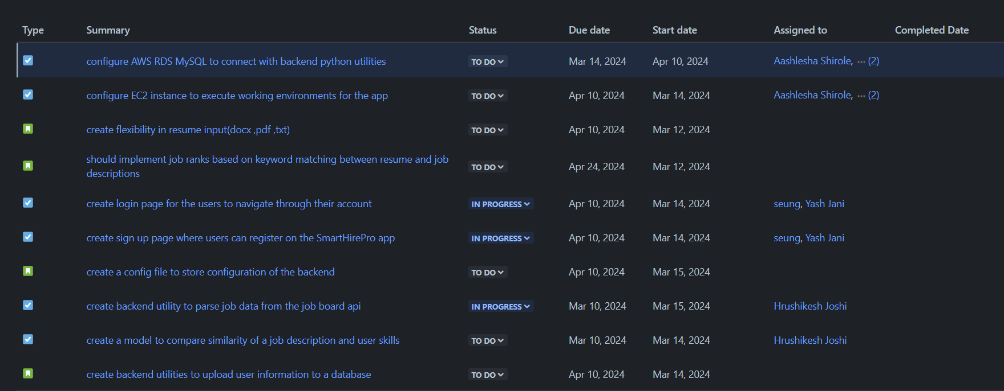
Sprint 3

Slide 35
UI/UX - UPLOAD PAGE

Slide 36
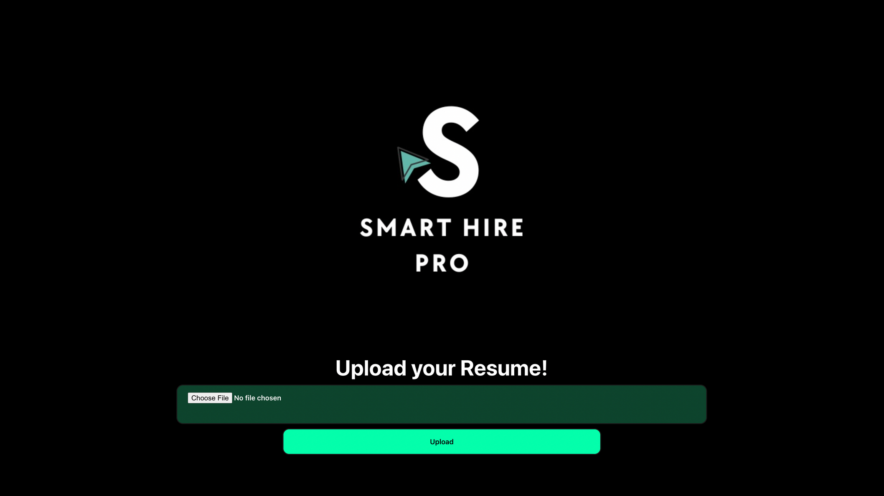

Slide 37
UI/UX -DASHBOARD

Slide 38
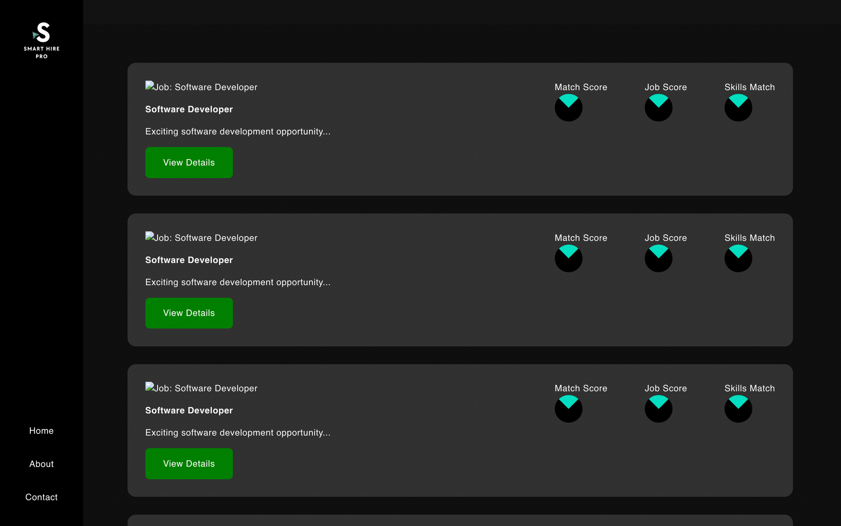

Slide 39
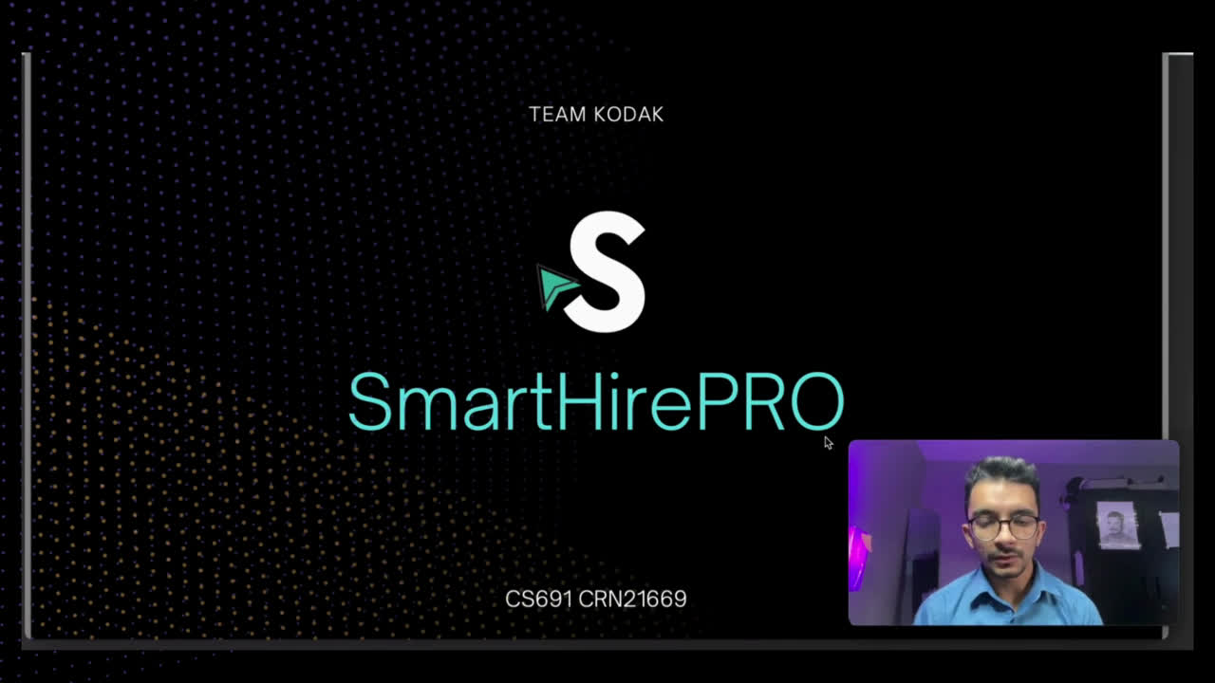
Live - DEMO
YOUTUBE LINK
https://youtu.be/l9tx6Ql0OUA

Slide 40
Github link
https://github.com/htmw/2024S-Kodak

Slide 41

Thank You!
Do you have any questions?

